Slide 1
Year 7 Residential 2026
Tuesday 12 May @ 5.30pm
Brunel & Grace Houses

Slide 2
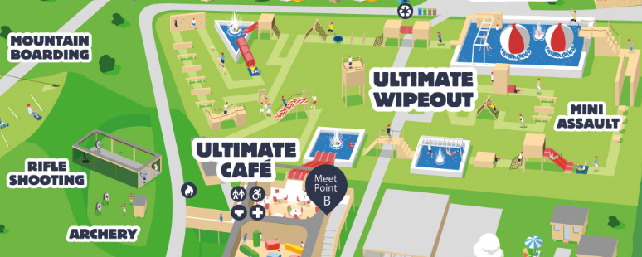

When and Where will it take place?
For 2 nights/3 days
The Ultimate Adventure Centre, Bideford, North Devon

Slide 3
Timetable - Mon 29 June - Wed 1 July (Brunel & Grace)
Mon 29 June
8.45am - ALL students to arrive and go to designated tutor rooms
10.00am departure (back car park)
12.00pm (approx) - arrival, settle in, lunch
1.30 - 3.00pm - Activity 1
3.30 - 5.00pm - Activity 2 (Archery, Rockets & Riddles, Scavenger Hunt - groups rotate) Final Activity List tbc
7.00 - 9.00pm - Activity 3 (Big Sheep OR Assault Course)
Tues 30 June
9.00 - 5.00pm - Surfing/Bodyboarding & Coastal Walk in Croyde
7.00 - 9.00pm - Activity 3 (Big Sheep OR Assault Course)
Wed 1 July
9.00 - 10.30am - Activity 1
11.00am - 12.30pm - Activity 2 (Archery, Rockets & Riddles, Scavenger Hunt - groups rotate)
1.00pm - Departure to arrive at Downend for 3.00pm approx

Slide 4
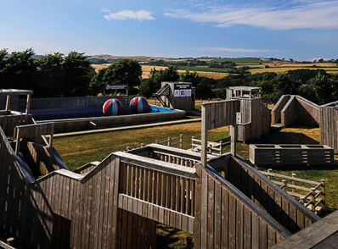
The Ultimate Assault Course

Slide 5
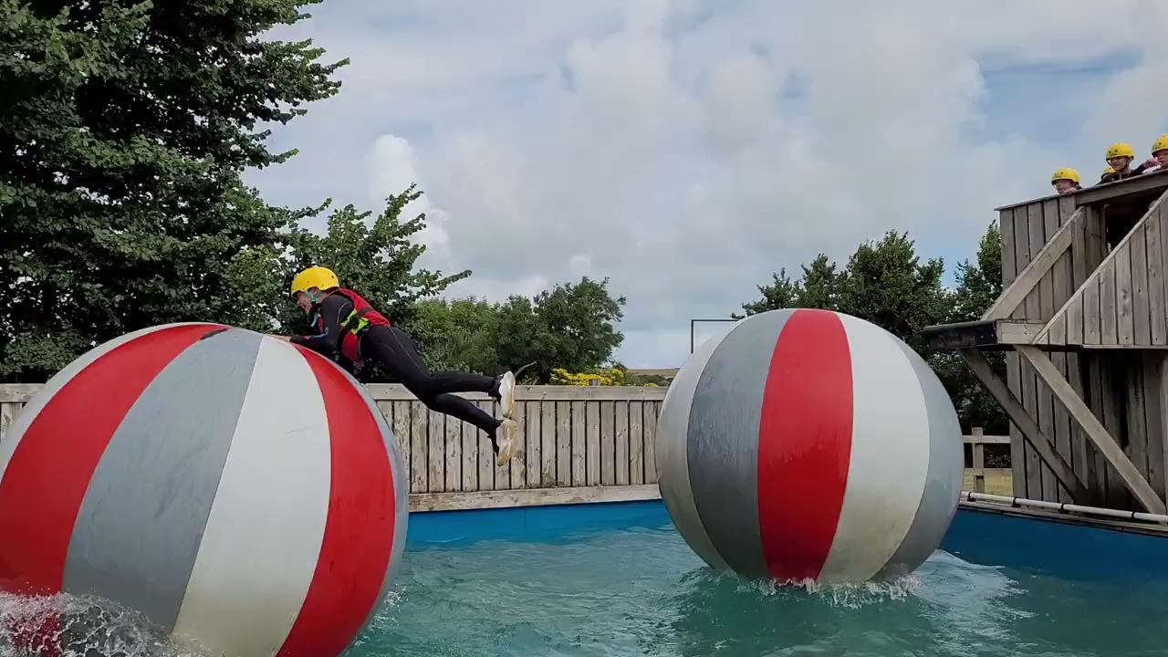
Activities - The Ultimate Assault Course

Slide 6
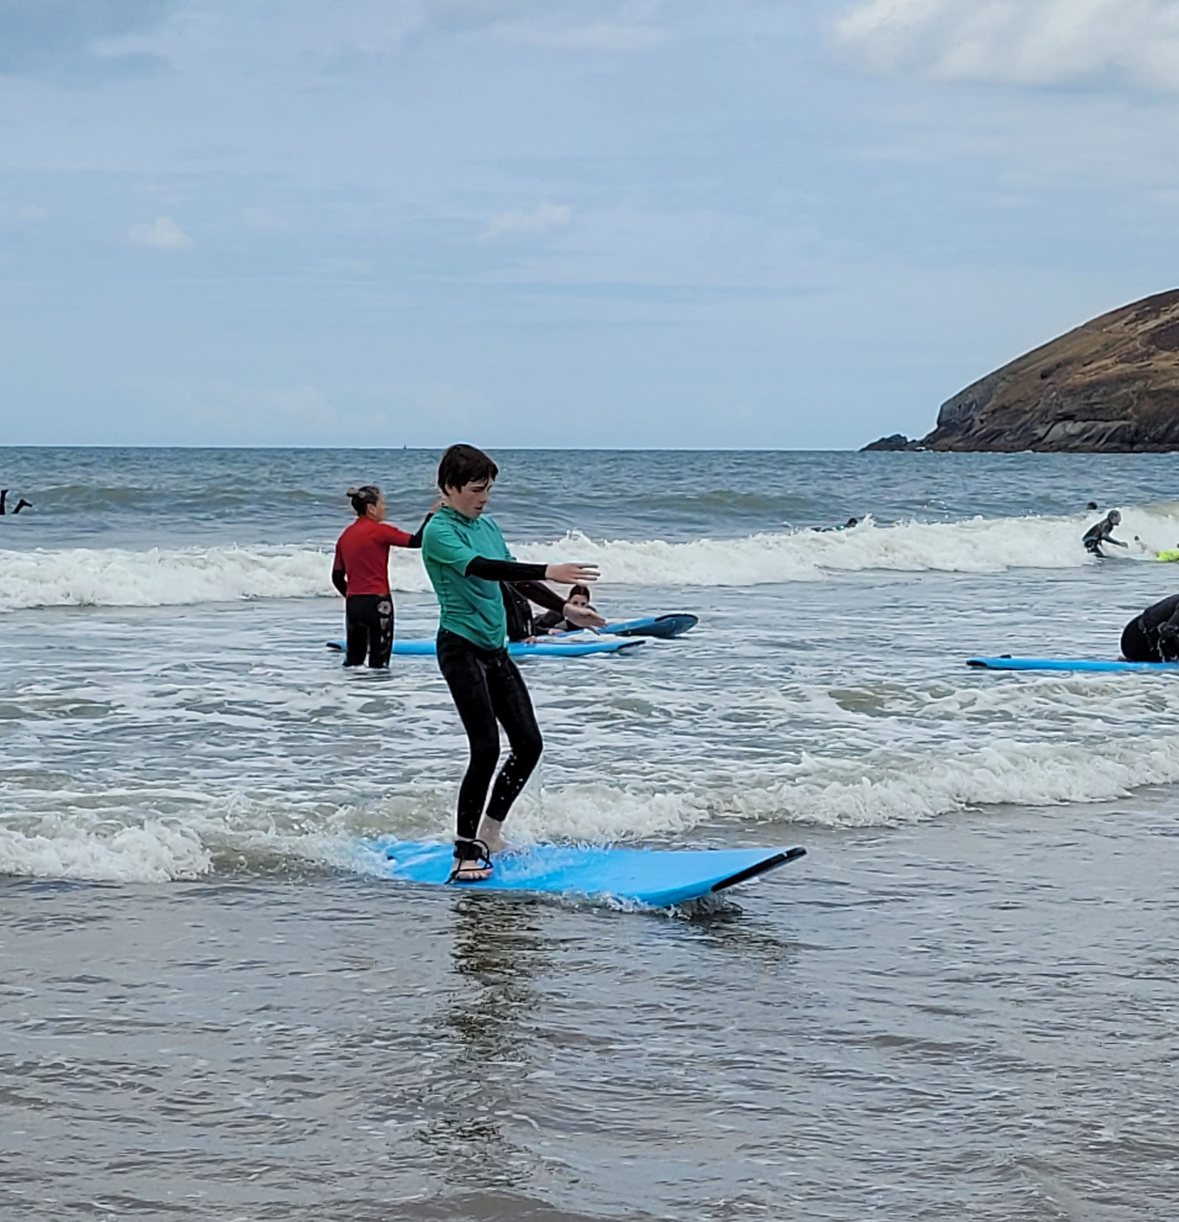
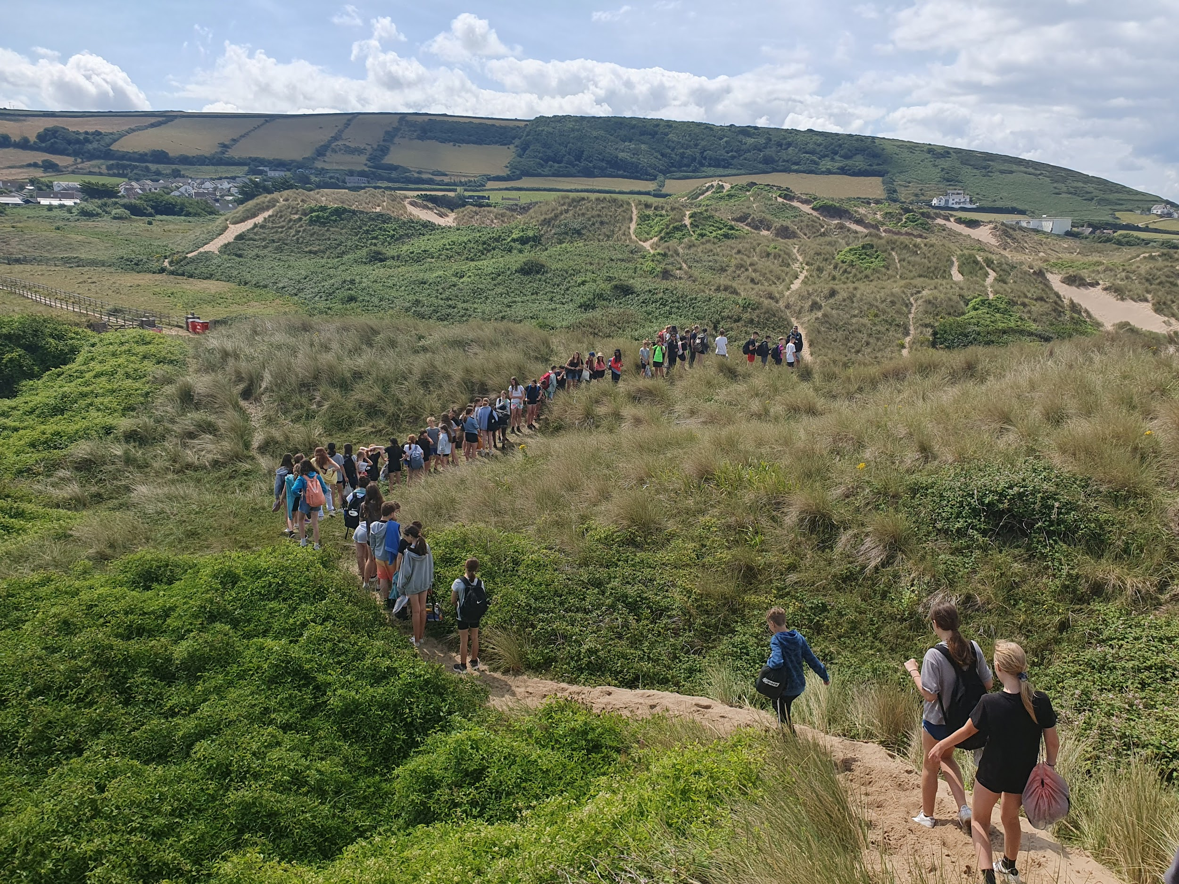
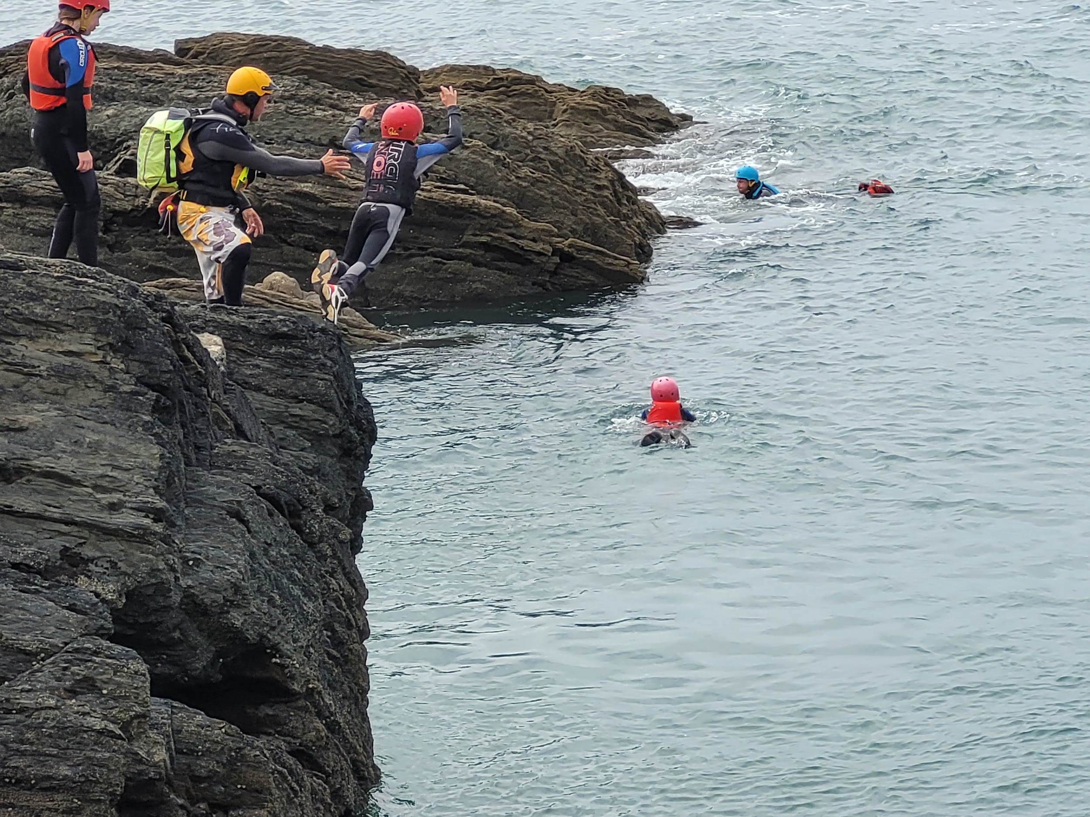
Activities - Bodyboarding/Coastal Walk/Coasteering

Slide 7
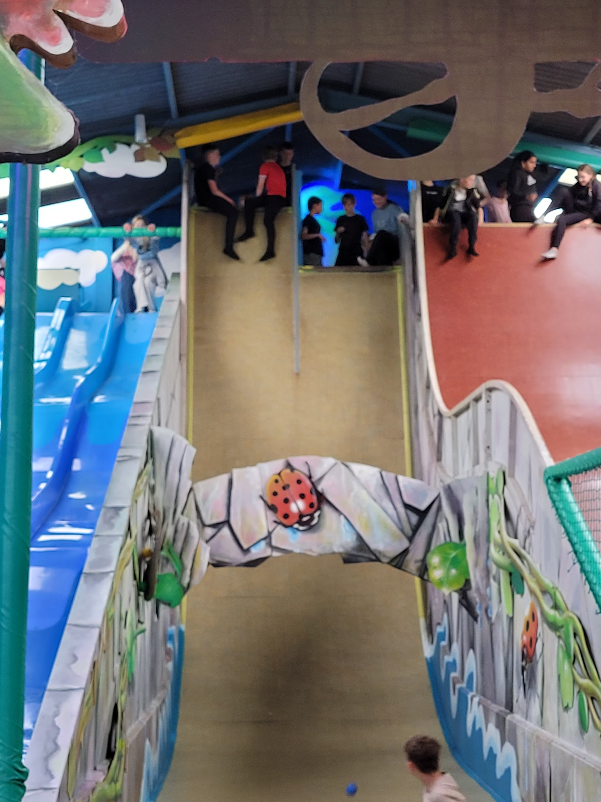
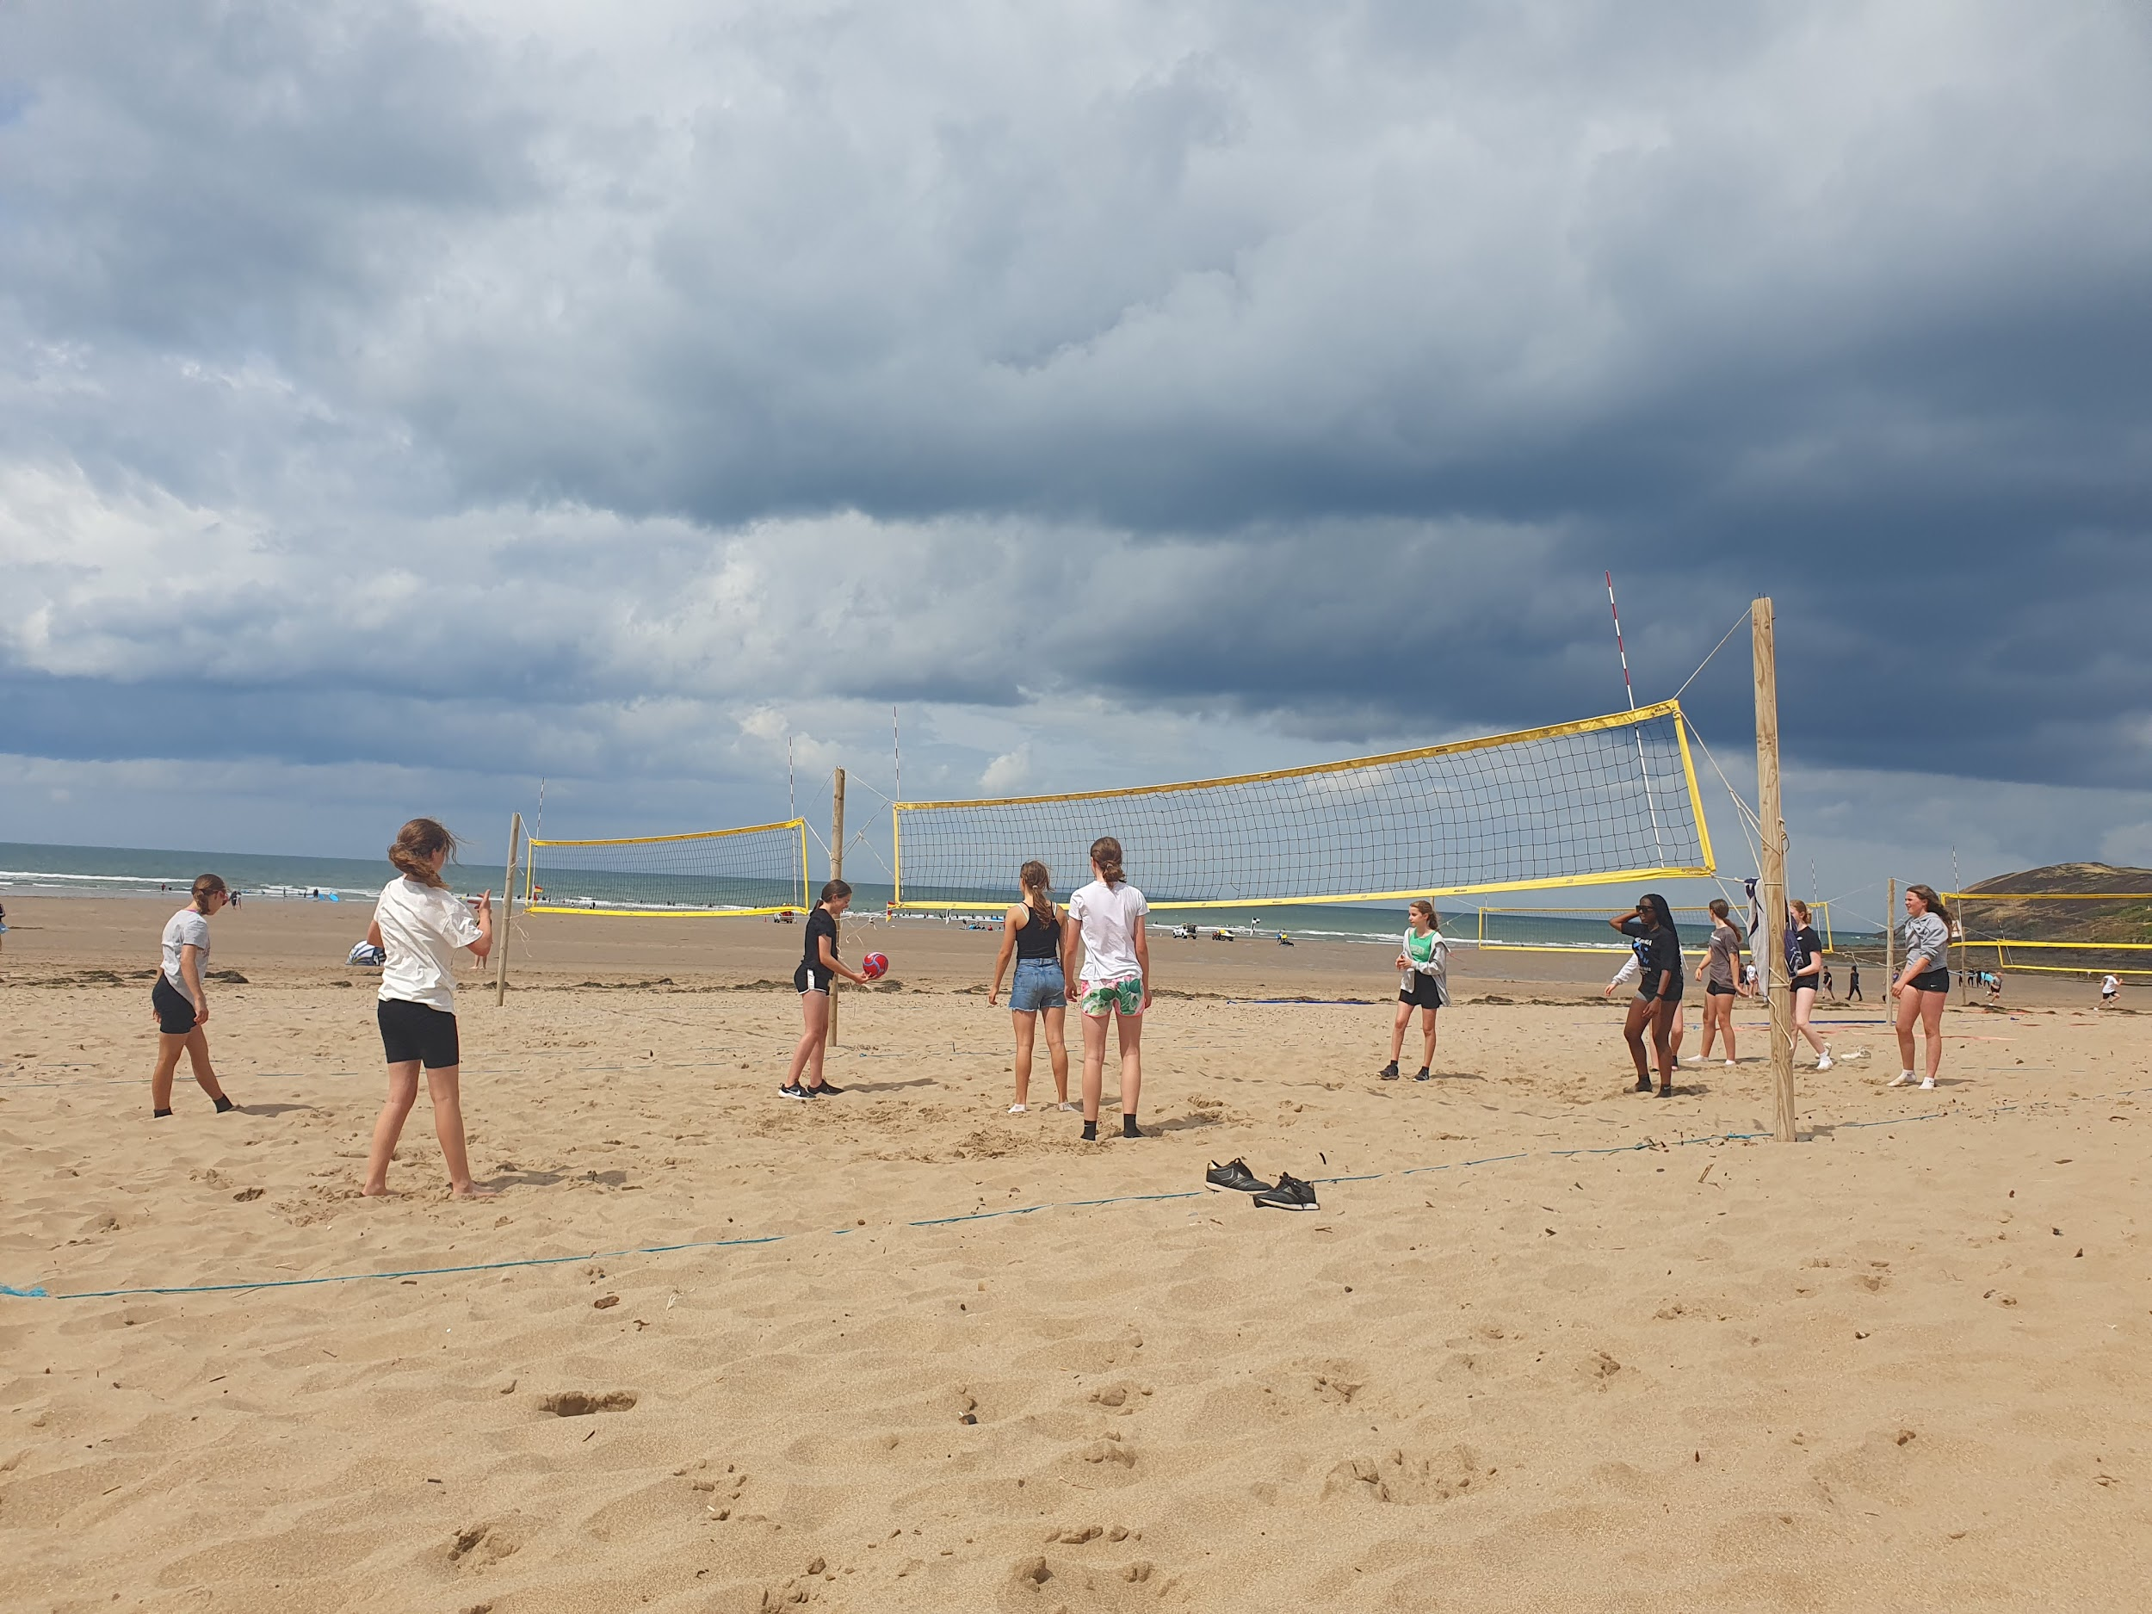
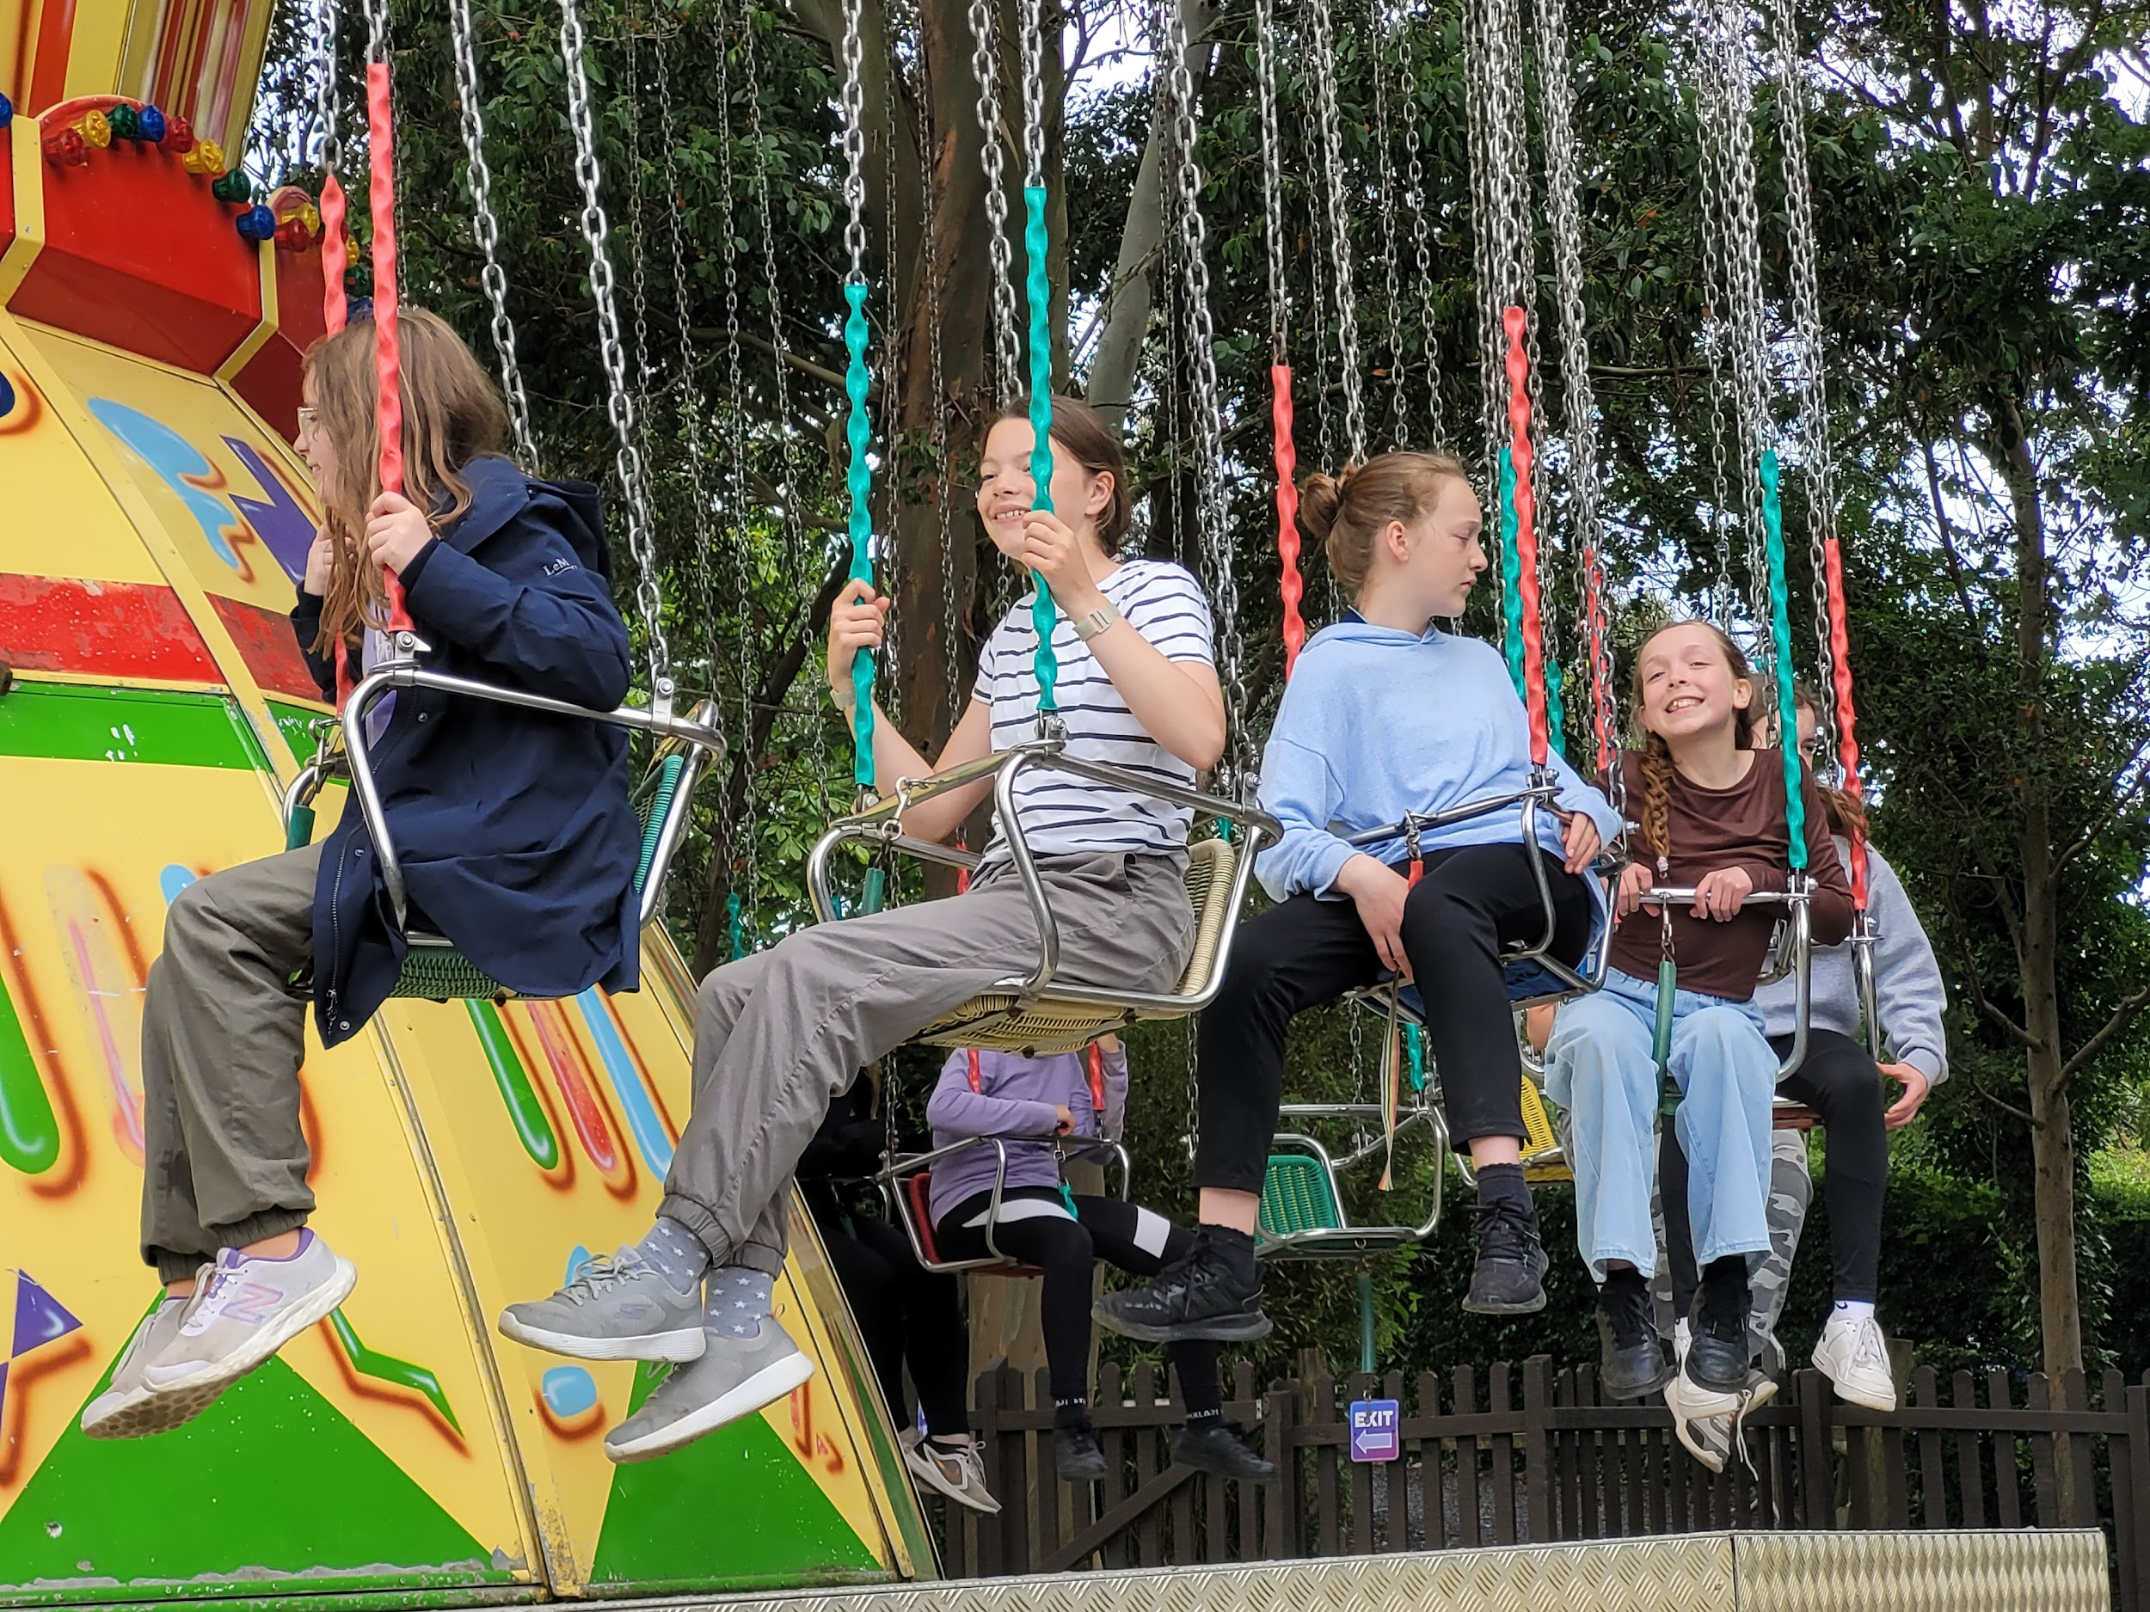
Activities - The Big Sheep / Beach Games

Slide 8
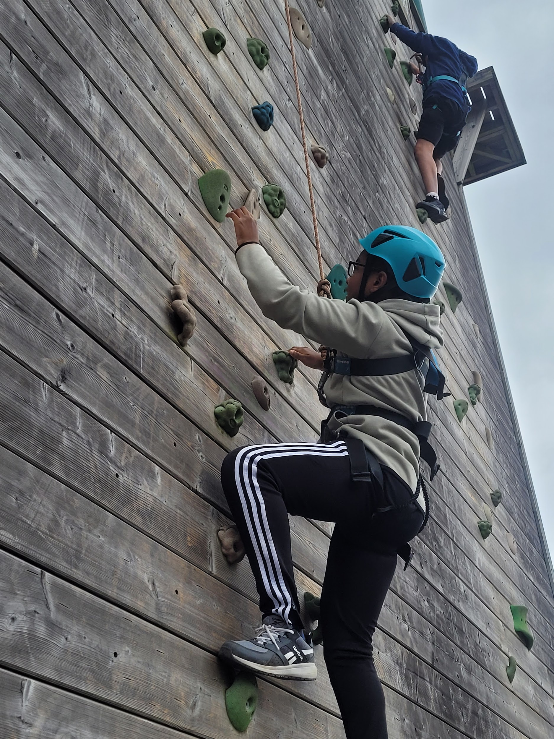
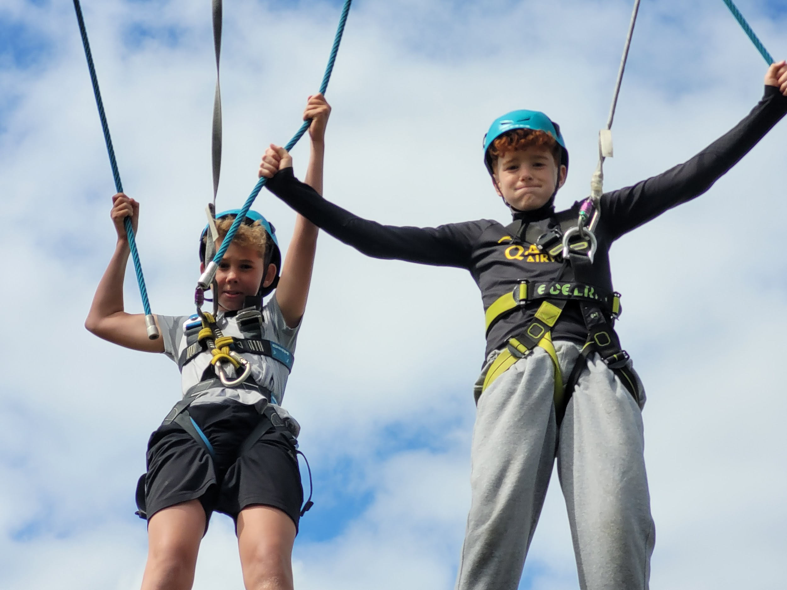
Activities - High Ropes / Climbing Wall

Slide 9
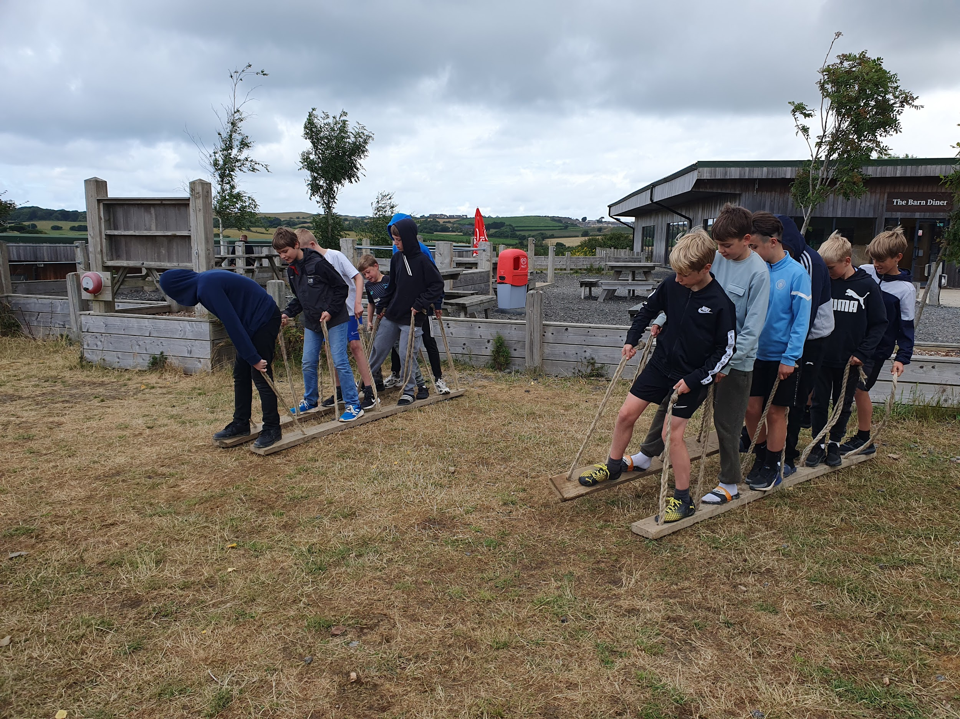
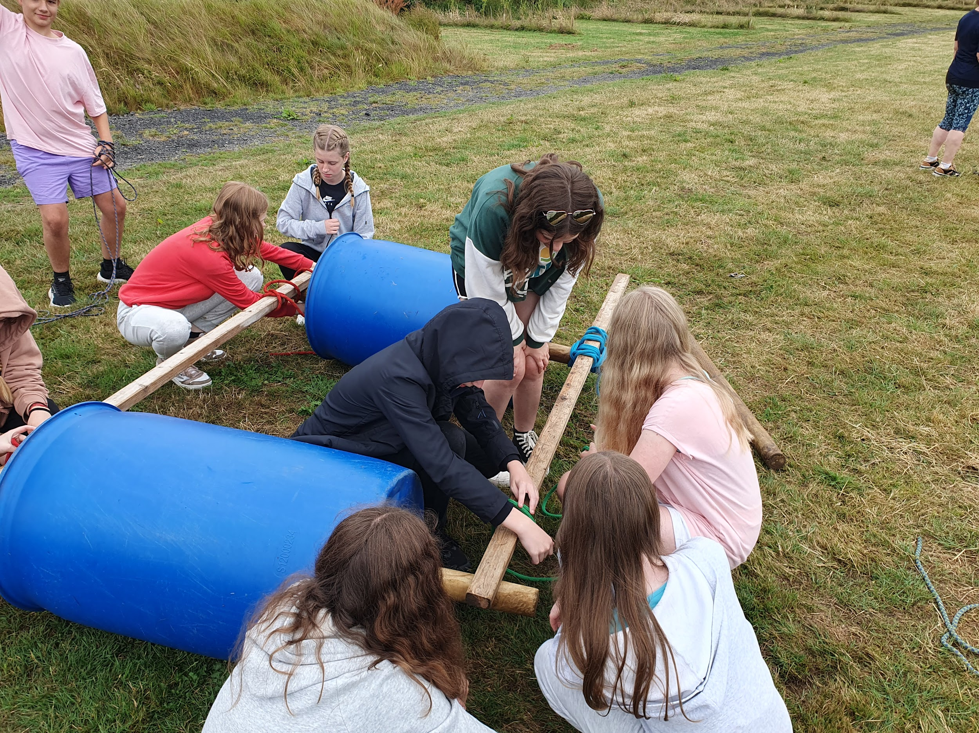
Activities - Rockets and Riddles

Slide 10
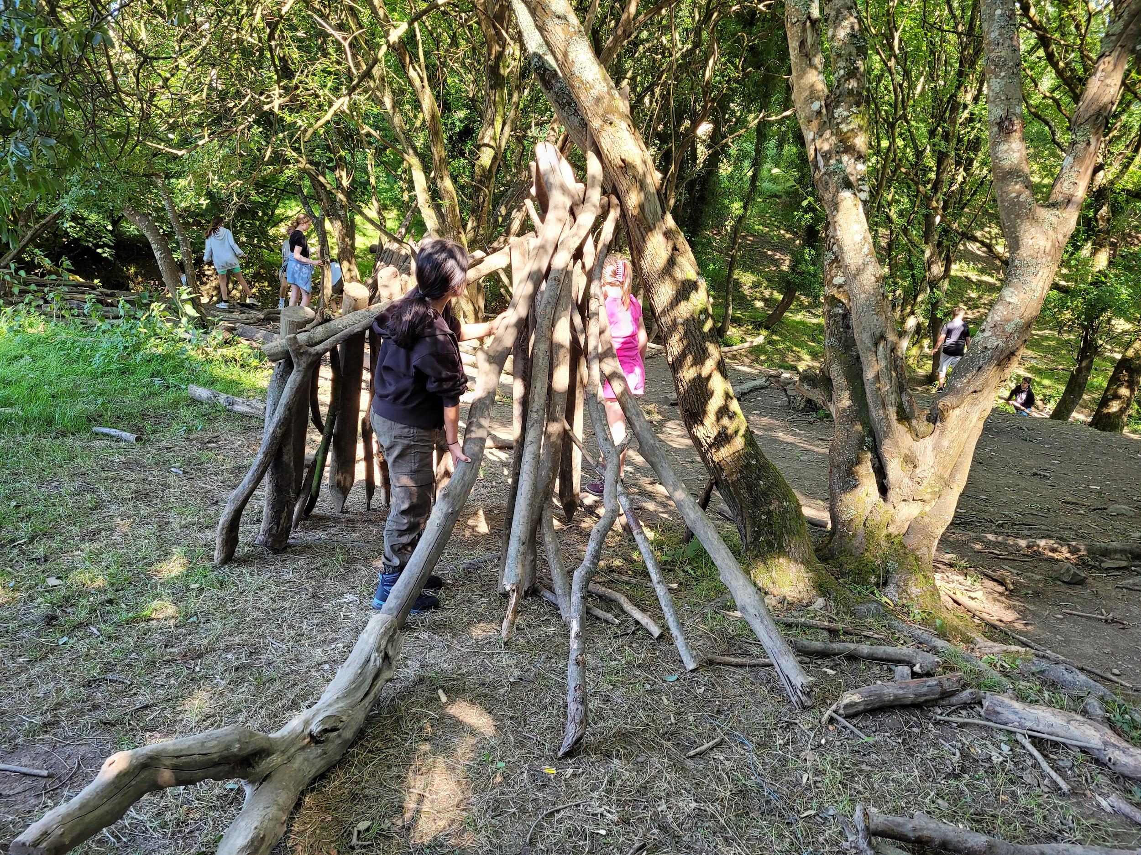
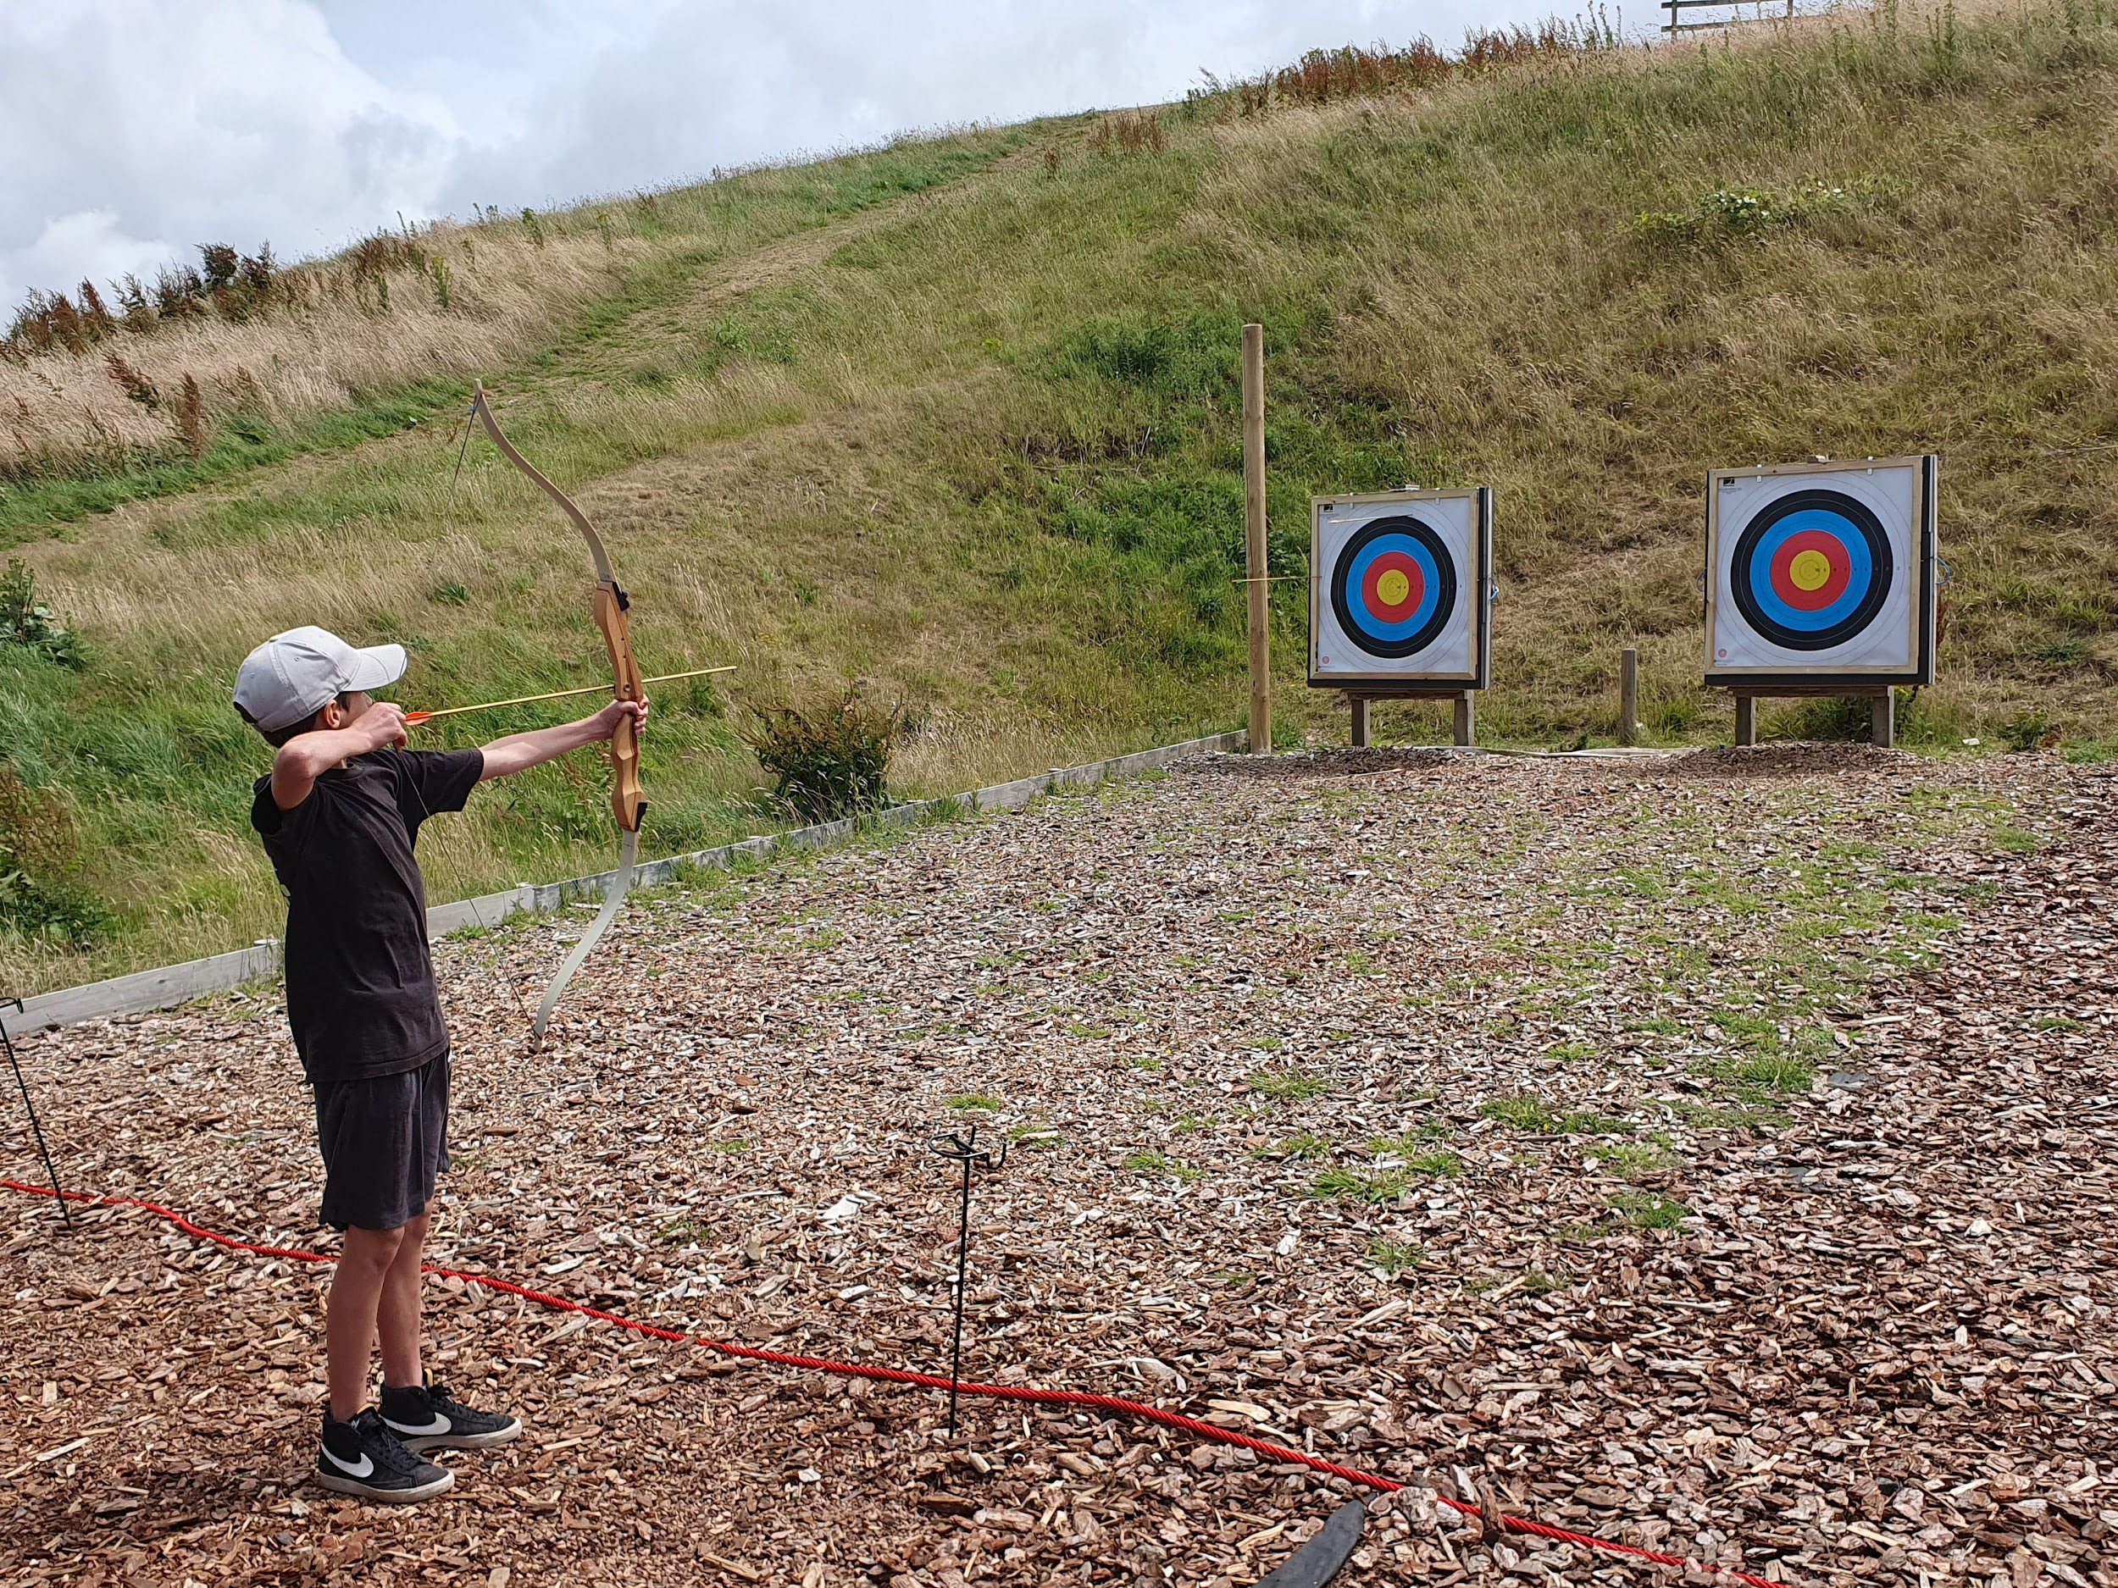
Activities - Den building / Archery

Slide 11
Activities - Website Link
Participation is key, but not forced
beach games available for those who do not go into water

Slide 12
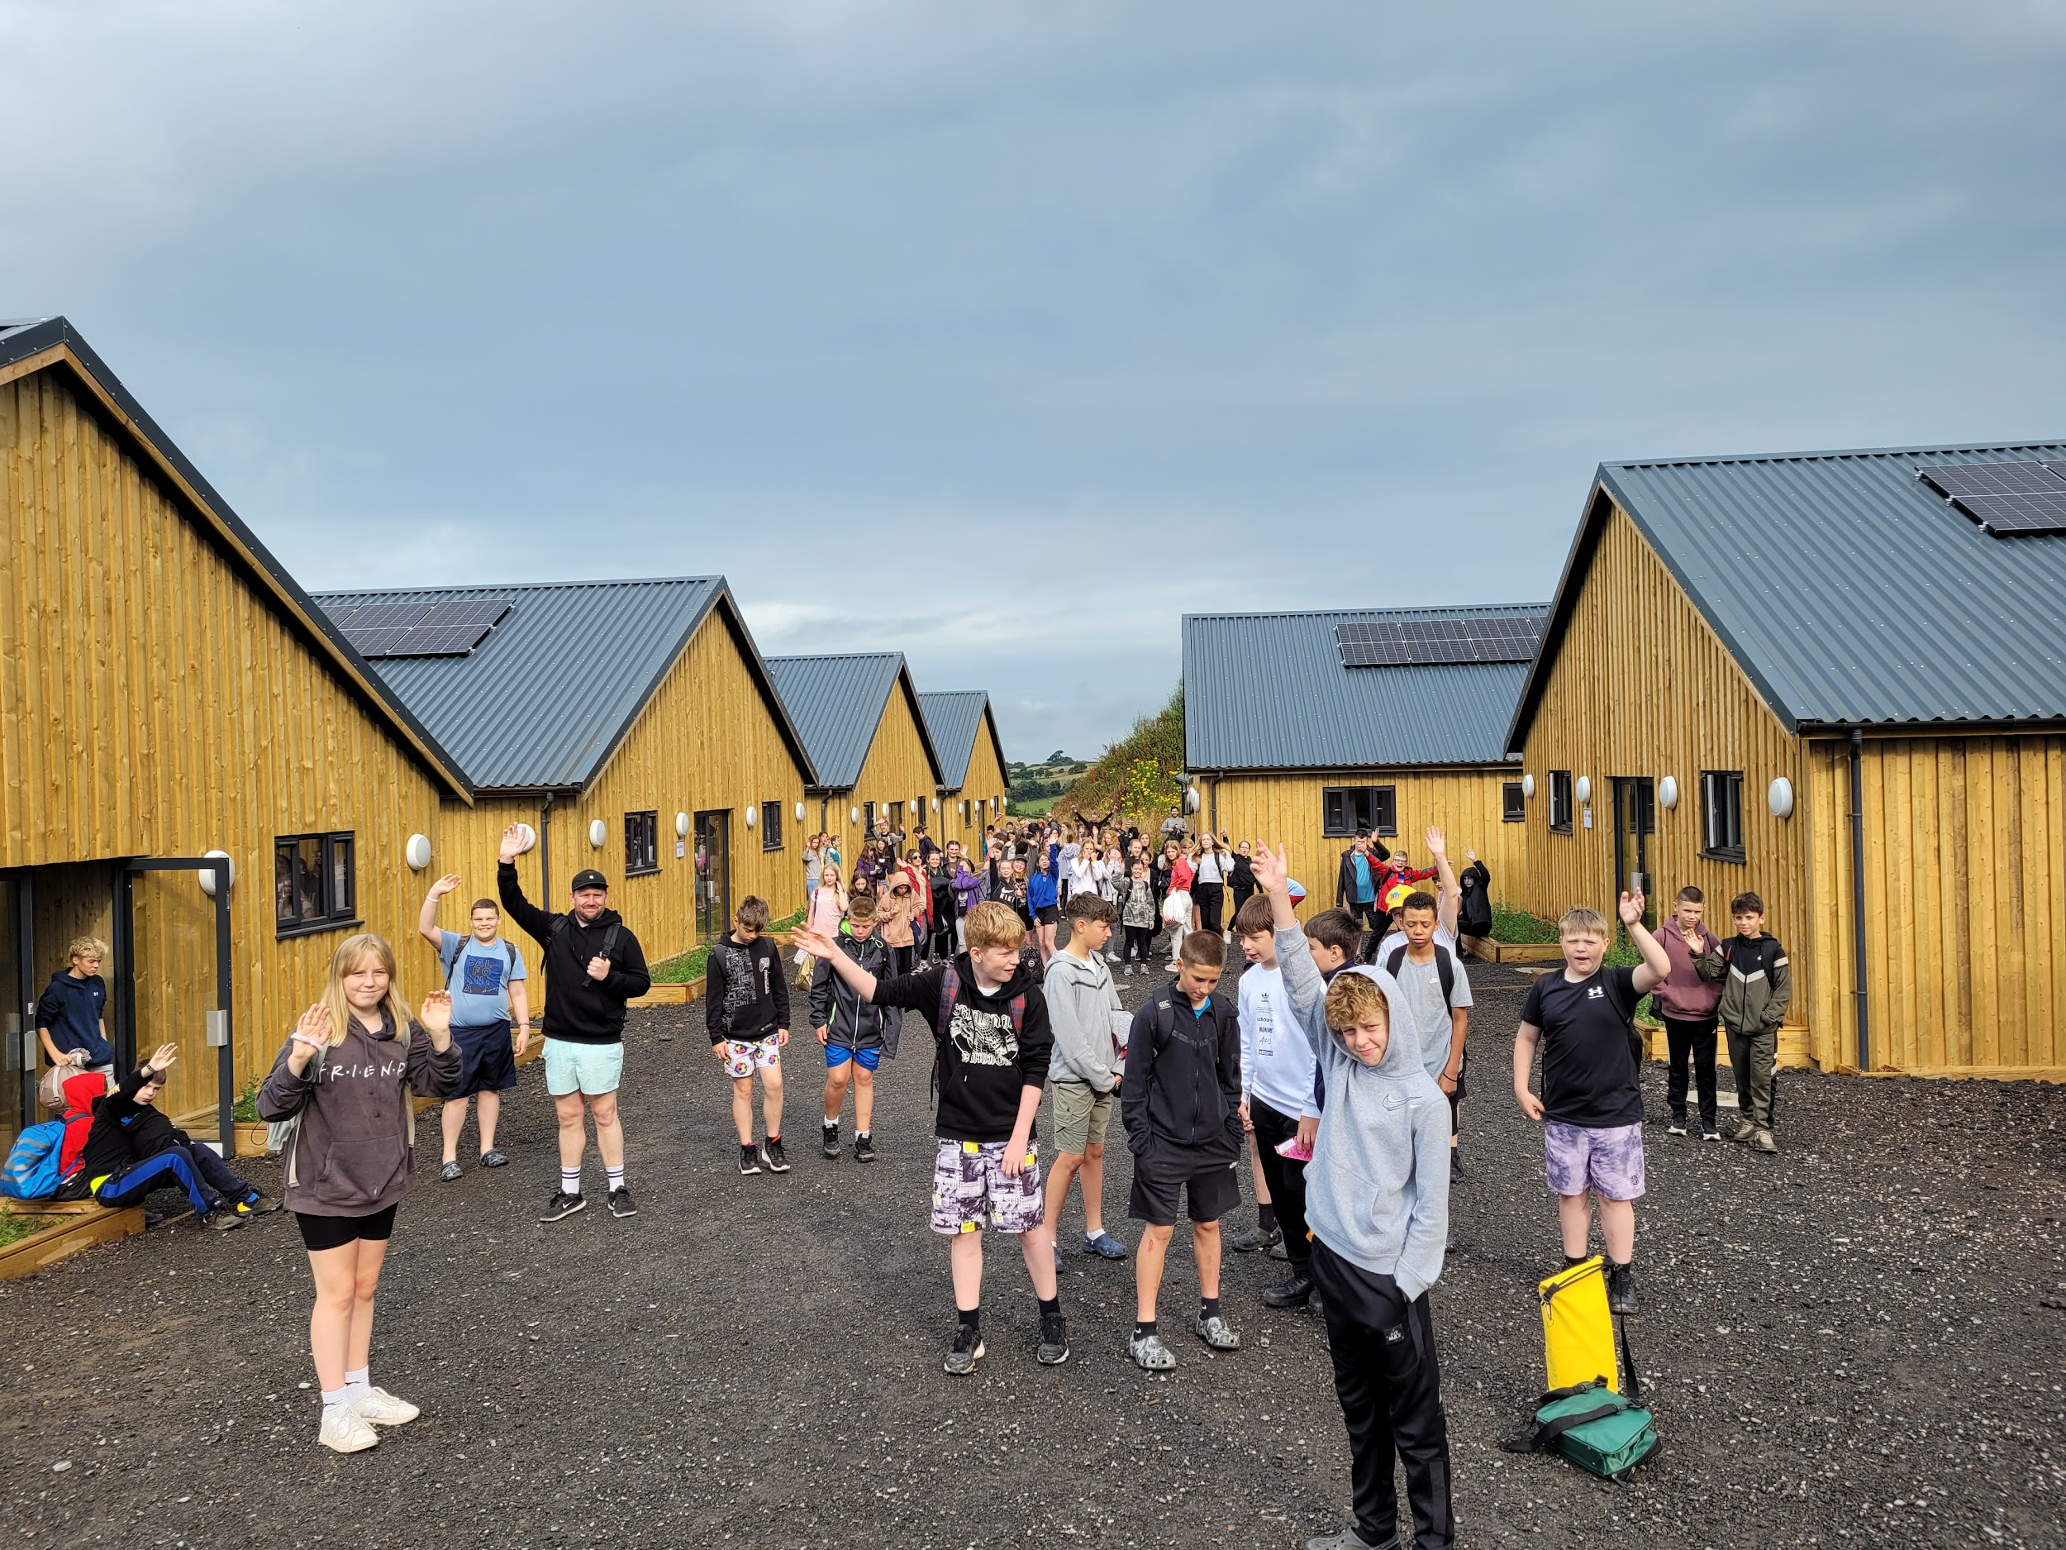
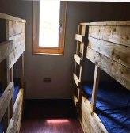
Facilities

Slide 13

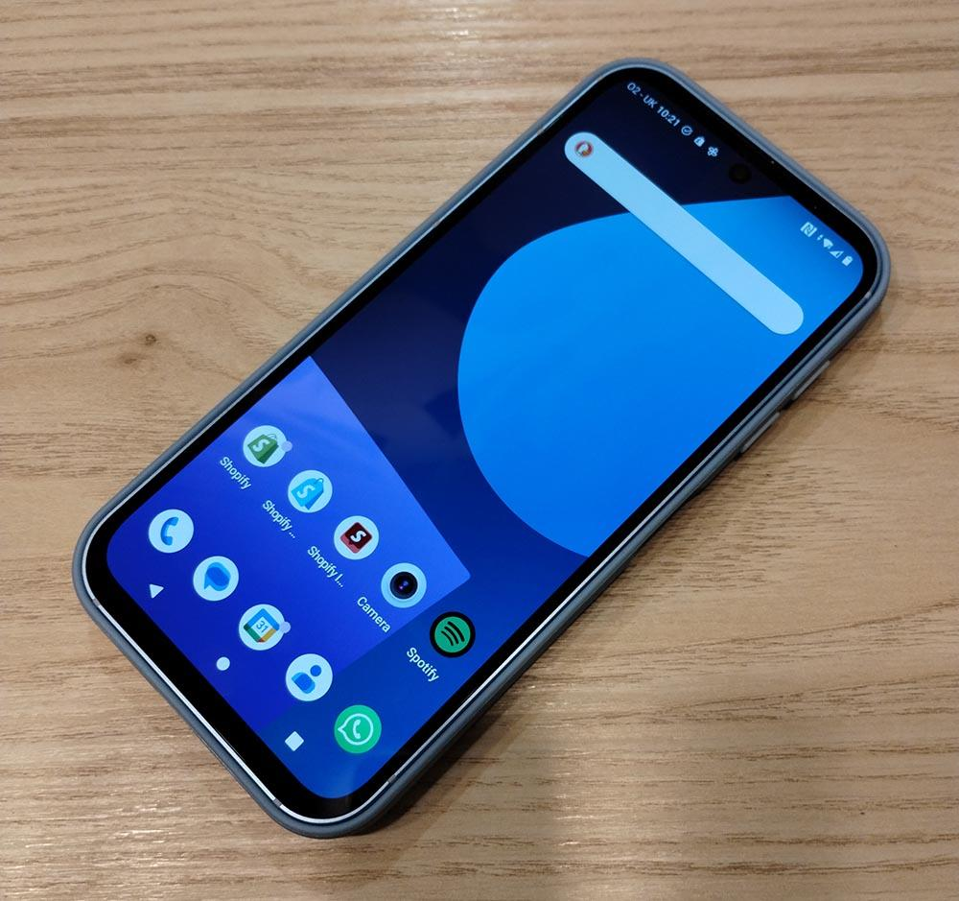
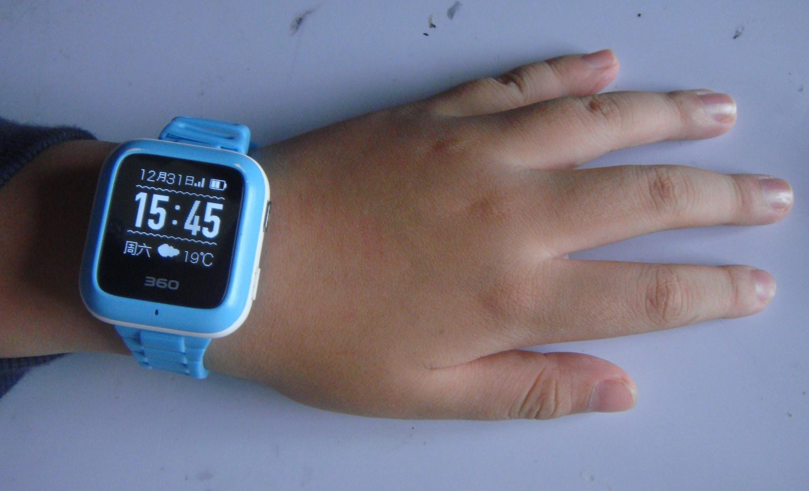
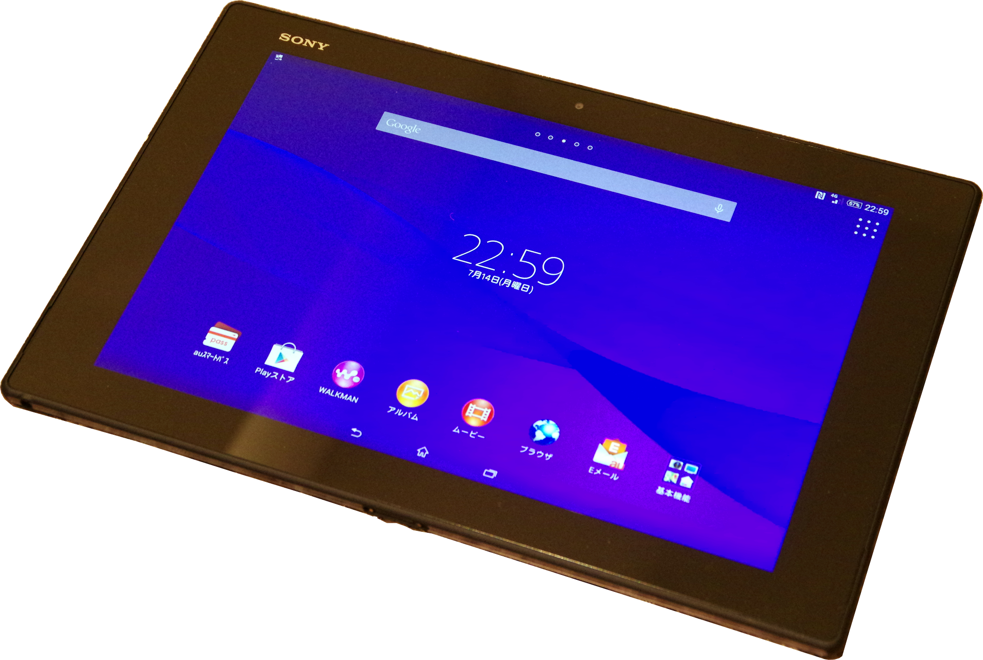
Mobile Phone Policy
Mobile phones, smart watches and other electronic devices must not be taken on the residential.
Staff will confiscate any of these items found and they will be returned once we have arrived back at Downend.

Slide 14
allergies
Please DO NOT send your child with ANY snacks or foods that are or that contain ANY form of nuts.

Slide 15
Kit List
All students will need to bring their personal equipment and should be encouraged to pack for themselves. This list is only a guide and not comprehensive.
Torch
Warm sweater, jumper or sweatshirt
Sun hat & sun cream
T-shirts or similar
Trousers and/or shorts
Spare socks (one pair per day)
Spare underclothes (one pair per day)
Indoor shoes (eg slippers, flip flops)
Nightwear
Trainers (suitable for outdoor activities) - open toe footwear cannot be worn on any activity
Waterproof jacket and trousers if you have them
Swimwear and 2nd towel (to be used after optional water activities)*
Sturdy/old trainers (suitable for getting wet)*
Plastic bags for dirty clothes
Personal washing requirements and towel
Water bottle (500ml +)

Slide 16
What next?
Accommodation
each cabin block has 6 rooms (4 x 6-bed rooms for students, 2 rooms for staff)
Dietary requirements
parents will be given additional forms if needed
parents to state student’s ability with water - please use the Google Form link here or the QR Code on the next slide
To discuss any specific medical requirements, please contact tony.rolle@cset.co.uk
Please include your child’s name and tutor group when contacting the school.

Slide 17
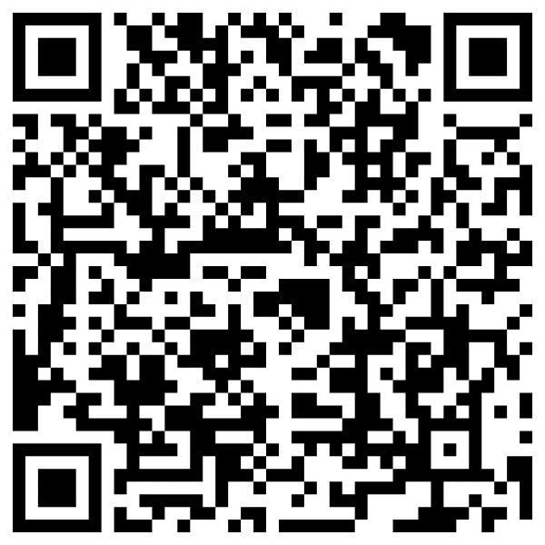
QR Code - Consent form for water activities
Please scan to give details of your child’s ability in water

